Slide 1
Object Oriented Programming

Slide 2
Course Material
Recommended Book(s)
For C++:
Object Oriented Programming in C++ by Robert Lafore (Recommended book).
C++ How to Program by Deitel and Deitel (Alternate book).

Slide 3
Basic Concepts of OOP
Object-oriented programming has four basic concepts, help you understand the basic functionality of an OOP computer program
Abstraction
Encapsulation
Inheritance
Polymorphism

Slide 4
Why OOP?
Modern computers are smaller, but far more complex than early computers.
They can execute many programs at the same time.
Computer scientists have introduced the notion of objects and object-oriented programming to help manage the growing complexity of modern computers

Slide 5
Introduction to OOP
Programming Paradigm for System Modeling.
Programming model/style that is associated with the concept of Class, Objects and various other concepts revolving around these two
Object Oriented Programming is a design concept.
It is nothing but a technique to design applications.

Slide 6
Understanding Object
An object is anything that can be represented by data in a computer’s memory and manipulated by a computer program.
An object is an instance of a class.
Anything that we see are nothing but objects.
Objects can be anything like pen, car, computer, bike, mobiles, etc.
If there are objects then they will have properties and behaviors, which will differentiate one object from other.
E.g.: Take an example of a car. Car has properties (Color, Model, and Brand) and behaviors (it can move forward and backward). Likewise different objects have different properties and behaviors.

Slide 7
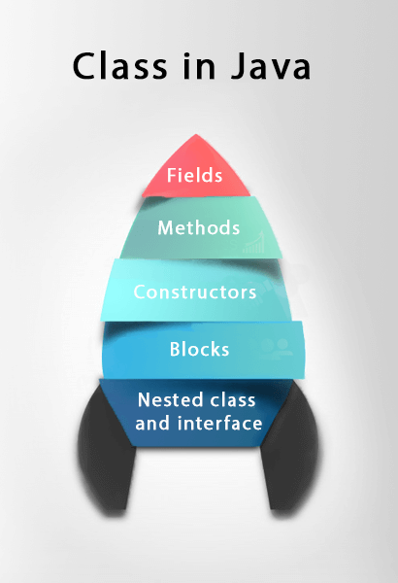
Understanding Class
Classes are something, which defines an object.
You can say Class is a blueprint of Object.
Collection of objects is called class.
It is a logical entity.
Class describes all properties and behaviors of an Object.
Classes define attributes and methods of the objects of its kind.
The act of creating a new instance of an object is called instantiation

Slide 8
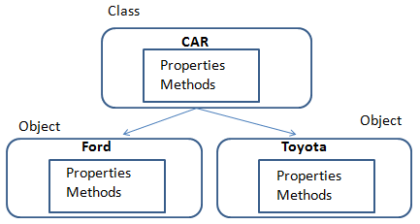
Class & Object

Slide 9
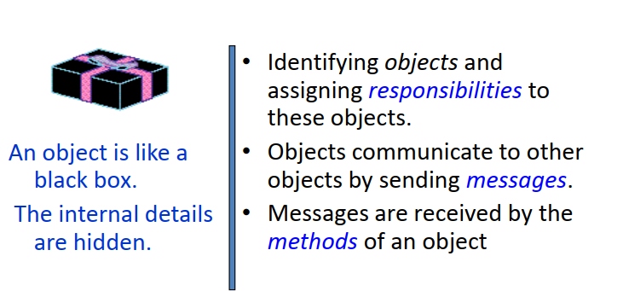
What is Object Oriented Programming?

Slide 10
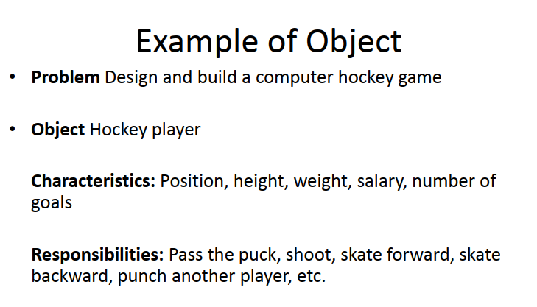

Slide 11
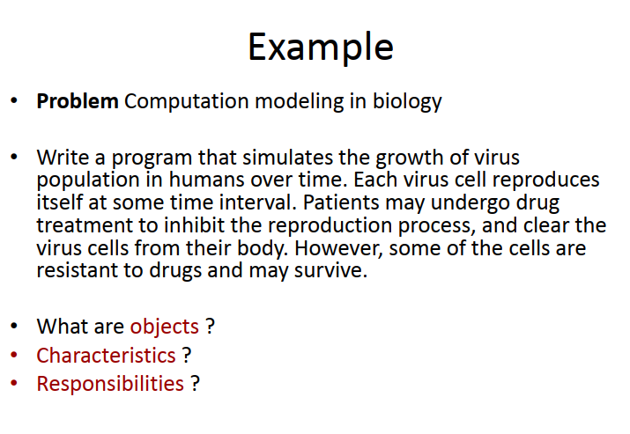
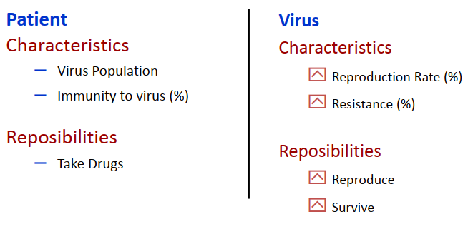

Slide 12
Object Oriented Language
We have specialized languages to program object-oriented-ly
– Research has shown that we seem to think in the language we speak
Easier to think in terms of objects using object oriented language rather than procedural languages

Slide 13
Characteristics of OOP
Everything is an object !
Computation is performed by objects communicating with each other
– Objects communicate by sending and receiving messages
Each object has its own memory, which consists of other objects
Every object is an instance of a class (has a type)
The class is the repository for behaviour associated with an object

Slide 14
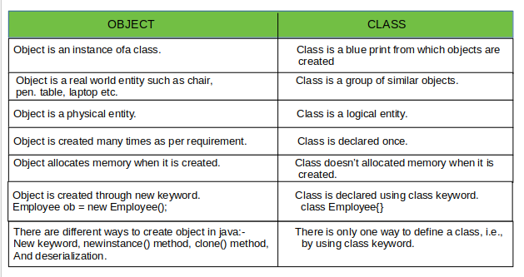
Object vs class

Slide 15
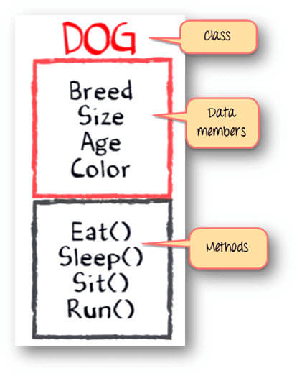
Structure of a class

Slide 16
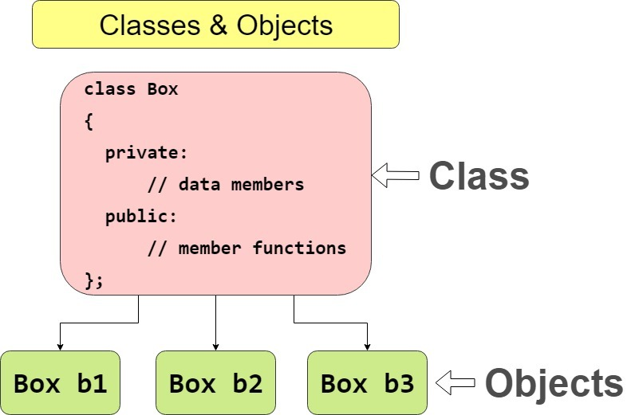

Slide 17
Structured vs object oriented programming
Structured programming focuses on procedures and functions, breaking down tasks into smaller, reusable blocks of code. There’s no concept of objects or classes.
Functions and data are separate.
The program flows from top to bottom, using functions to operate on the data.
No direct relationship between data and functions.
OOP focuses on objects, which encapsulate both data (attributes) and functions (methods) that operate on that data. It supports features like inheritance, polymorphism, and encapsulation.
Objects encapsulate both data and methods.
Code revolves around objects that interact with each other. The class Car represents a blueprint, and each car object has its own properties and behaviors.
It's more modular, supporting principles like encapsulation, inheritance, and polymorphism.

